Slide 1
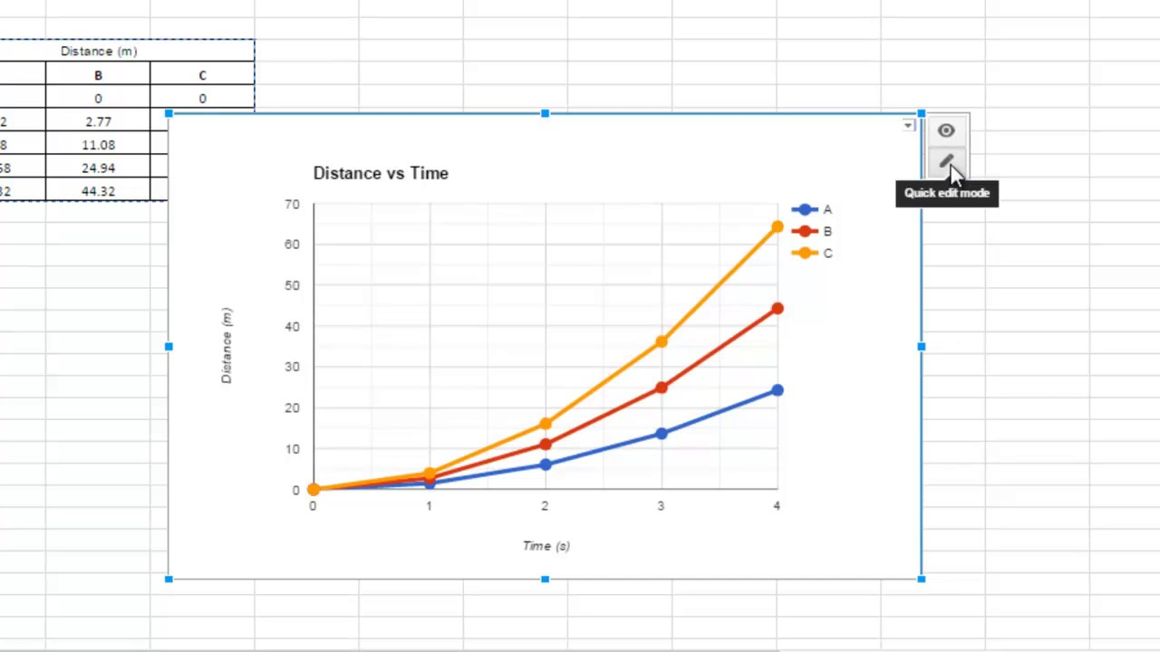

KW: Approaching Text Based Subreddits Through Machine Learning
Hagan Brewer, Joshua Brucker, Solomon King, Nelson Vargas
Abstract: A large part of reddit's success as a "social news aggregation, web content rating, and discussion website" should be accredited to the implementation of karma as a powerful reward system that the users can use to control what content can be viewed. Posts and inevitably users that gain large amounts of upvotes (a large karma score) are viewed with greater frequency and in higher regard respectively. Our team endeavors to build a heuristic system to grade the degree to which a new reddit post will be popular within its respective subreddit. The team intends to quantify what makes a reddit post successful and strictly adheres to ethical research practices with respect to social engineering.
Motivation: A large part of reddit's success as a "social news aggregation, web content rating, and discussion website" should be accredited to the implementation of karma as a powerful reward system that the users can use to control what content can be viewed. Posts and inevitably users that gain large amounts of upvotes (a large karma score) are viewed with greater frequency and in higher regard respectively. Our team endeavors to build a heuristic system to grade the degree to which a new reddit post will be popular within its respective subreddit. The team intends to quantify what makes a reddit post successful and strictly adheres to ethical research practices with respect to social engineering.
Approach: A large part of reddit's success as a "social news aggregation, web content rating, and discussion website" should be accredited to the implementation of karma as a powerful reward system that the users can use to control what content can be viewed. Posts and inevitably users that gain large amounts of upvotes (a large karma score) are viewed with greater frequency and in higher regard respectively. Our team endeavors to build a heuristic system to grade the degree to which a new reddit post will be popular within its respective subreddit. The team intends to quantify what makes a reddit post successful and strictly adheres to ethical research practices with respect to social engineering.
Figure 1: This figure shows some cool aspect of our project
Technologies:
Tech
More tech
More more tech
Some more stuff
Features:
Tech
More tech
More more tech
Some more stuff
Conclusion: A large part of reddit's success as a "social news aggregation, web content rating, and discussion website" should be accredited to the implementation of karma as a powerful reward system that the users can use to control what content can be viewed. Posts and inevitably users that gain large amounts of upvotes (a large karma score) are viewed with greater frequency and in higher regard respectively. Our team endeavors to build a heuristic system to grade the degree to which a new reddit post will be popular within its respective subreddit. The team intends to quantify what makes a reddit post successful
Figure 1: This figure shows some cool aspect of our project
Future Work: Where do we go now. Where do we go now where do we go now where do we go now where do we go now
Visit our Repo at https://github.com/csc4790-fall2019/sp-hagan-solomon-josh-nelson/wiki or Scan the QR Code
We would like to acknowledge the follow people for their help: Dr. Benjamin Mitchell, Jason Dobies, Villanova Computer Science Department

